Slide 1
Meditation Practices that Involve Contemplation and/or Concentration, e.g., Visualization, Guided Imagery, and Mindful Focusing, etc.
Active
Mind
Waking
State
Deep
Relaxation
Transcending
Transcendental Meditation
EEG
Coherence
Restful
Alertness
Transcendental Consciousness
4th State — Bliss
Laozi—the Tao
Plato—the Good, the One, the Beautiful
Plotinus—the Infinite
Christianity—the Kingdom of Heaven Within
Ralph Waldo Emerson— the Oversoul

Slide 2
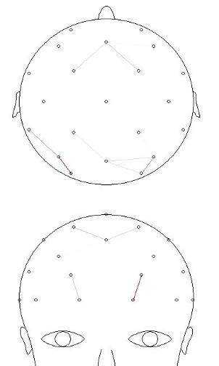
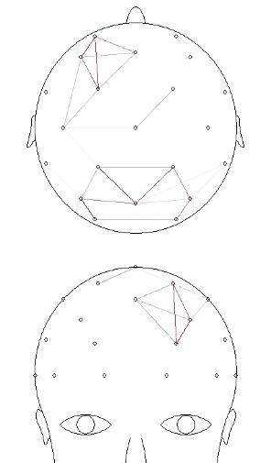
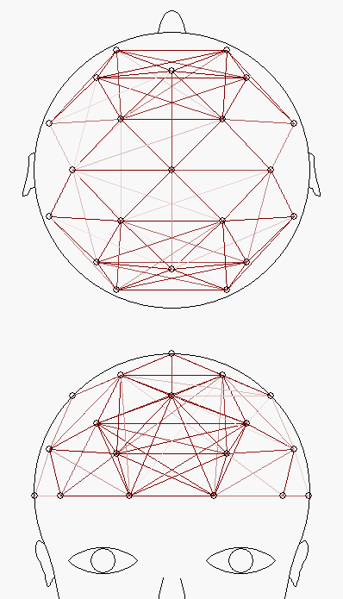
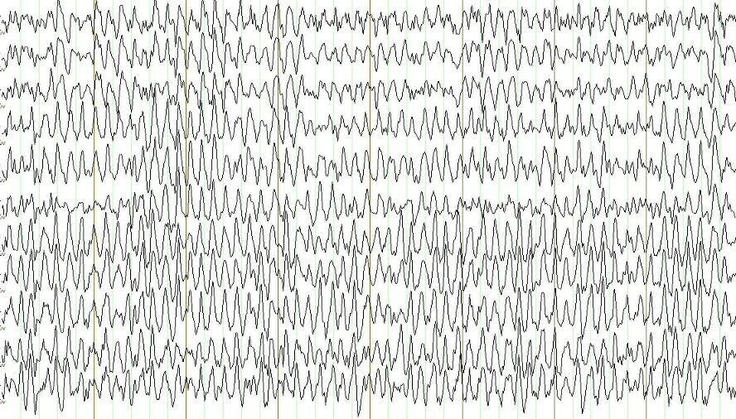
Increased EEG Coherence through the Transcendental Meditation technique
Front
Middle
Eyes Open
Eyes Closed
TM Practice
References: International Journal of Psychophysiology, 116, 1519-38 (2006); Biological Psychology, 61, 293-319 (2002); Consciousness and Cognition, 8(3), 302-18 (1999); Electroencephalography and Clinical Neurophysiology, 35 (1973); International Journal of Neuroscience 14: 147–151, 1981.
Notes:
2
The same subject is shown, with eyes closed before learning TM, and then 3 months later during TM practice.

Slide 3
Feeling Less Old through the Transcendental Meditation technique
p < .05
No Treatment
5
Relaxation Response
TM technique
Mindfulness
4
Feeling Old Rating Scale *
3
2
Reference: Alexander, C. N., Langer, E. J., Newman, R. I., Chandler, H. M., and Davies, J. L. (1989). Transcendental Meditation, mindfulness, and longevity: an experimental study with the elderly. Journal of Personality and Social Psychology, 57 (6): 950–964.

Slide 4
Improved Cognitive Flexibility through the Transcendental Meditation technique
100
TM technique
p < .001
75
Mindfulness
% Correct at Posttest *
50
Relaxation Response
No Treatment
25
0
Reference: Alexander, C. N., Langer, E. J., Newman, R. I., Chandler, H. M., and Davies, J. L. (1989). Transcendental Meditation, mindfulness, and longevity: an experimental study with the elderly. Journal of Personality and Social Psychology, 57 (6): 950–964.

Slide 5
Improved Associate Learning through the Transcendental Meditation technique
TM technique
p < .05
6
Relaxation Response
Mindfulness
5
Wechsler Memory Scale *
4
No Treatment
3
Reference: Alexander, C. N., Langer, E. J., Newman, R. I., Chandler, H. M., and Davies, J. L. (1989). Transcendental Meditation, mindfulness, and longevity: an experimental study with the elderly. Journal of Personality and Social Psychology, 57 (6): 950–964.

Slide 6
Decreased Systolic Blood Pressure through the Transcendental Meditation technique
p < .01
Relaxation Response
145
No Treatment
135
Systolic Blood Pressure (mm Hg)
Mindfulness
TM technique
125
115
Reference: Alexander, C. N., Langer, E. J., Newman, R. I., Chandler, H. M., and Davies, J. L. (1989). Transcendental Meditation, mindfulness, and longevity: an experimental study with the elderly. Journal of Personality and Social Psychology, 57 (6): 950–964.

Slide 7
Increased Longevity through the Transcendental Meditation technique
TM technique
100
p < .00025
Mindfulness
90
No Treatment
80
% Alive After 36 Months
Relaxation Response
70
Other
60
50
Reference: Alexander, C. N., Langer, E. J., Newman, R. I., Chandler, H. M., and Davies, J. L. (1989). Transcendental Meditation, mindfulness, and longevity: an experimental study with the elderly. Journal of Personality and Social Psychology, 57 (6): 950–964.

Slide 8
Effects of stress reduction on all-cause mortality on older subjects: Pooled results of two randomized trials (N = 202)
RR = .77, p < .04
100
80
TM technique
60
Combined controls
Cumulative % Surviving
40
20
0
0
5
10
15
20
Years

Slide 9
Effects on Carotid Atherosclerosis in African Americans with Hypertension
+ 0.1
Change in Carotid Intima-Media Thickness (mm)
p < .045
+ 0.05
0
- 0.05
TM technique
- 0.1
Health Education
- 0.15
Reference: Castillo-Richmond, A., Schneider, R. H., Alexander, C. N., Cook, R., Myers, H., Nidich, S., et al. (2000). Effects of stress reduction on carotid atherosclerosis in hypertensive African Americans. Stroke, 31: 568–573.

Slide 10
Increased Physiological Relaxation Meta-analysis of 32 studies
TM technique
Plasma Lactate
Rest
Respiration Rate
Basal GSR
0
0.2
0.4
0.6
0.8
1.0
Effect Size (Standard Deviations)
Reference: Dillbeck, M., and Orme-Johnson, D. (1987). American Psychologist, 42, 879–881.

Slide 11
Effectiveness in Reducing Trait Anxiety Meta-analysis of 146 studies
TM technique
Placebo
Other Relaxation
Relaxation Response
Other Meditation
PMR
EMG-Biofeedback
Mantra Meditation
Concentration
0
0.2
0.4
0.6
0.8
1.0
Effect Size (Standard Deviations)
Reference: Eppley, K., Abrams, A., Shear, J. (1989). Differential effects of relaxation techniques on trait anxiety: a meta-analysis. Journal of Clinical Psychology, 45 (6): 957–974.

Slide 12
Increased Self-Actualization Meta-analysis of 42 studies
TM technique
Other Relaxation
Other Meditation
0
0.2
0.4
0.6
0.8
1.0
Effect Size (Standard Deviations)
Reference: Alexander, C. N., Rainforth, M., & Gelderloos, P. (1991). Journal of Social Behavior and Personality, 6, 189–247.

Slide 13
Effectiveness in Decreasing Alcohol Use Meta-analysis of 97 studies
TM technique
Peer Influence
Relaxation
DUI Programs
Preventive Education
0
0.2
0.4
0.6
0.8
1.0
Effect Size (Standard Deviations)
Alexander, C.N., Robinson, P., & Rainforth, M. (1994). Treating and preventing alcohol, nicotine, and drug abuse through Transcendental Meditation: A review and statistical meta-analysis. Alcoholism Treatment Quarterly, 11, 13–88.

Slide 14
Effectiveness in Decreasing Drug Abuse Meta-analysis of 70 studies
TM technique
Peer Influence
Preventive Education
0
0.2
0.4
0.6
0.8
1.0
Effect Size (Standard Deviations)
Alexander, C.N., Robinson, P., & Rainforth, M. (1994). Treating and preventing alcohol, nicotine, and drug abuse through Transcendental Meditation: A review and statistical meta-analysis. Alcoholism Treatment Quarterly, 11, 13–88.

Slide 15
Effectiveness in Decreasing Cigarette Use Meta-analysis of 131 studies
TM technique
Unconventional Treatment
Pharmacological Treatment
Individual Counseling
Self-help Kits
0
0.2
0.4
0.6
0.8
1.0
Effect Size (Standard Deviations)
Alexander, C.N., Robinson, P., & Rainforth, M. (1994). Treating and preventing alcohol, nicotine, and drug abuse through Transcendental Meditation: A review and statistical meta-analysis. Alcoholism Treatment Quarterly, 11, 13–88.

Slide 16
Improved Psychological Outcomes Meta-analysis of 51 studies
TM technique
Zen
Relaxation Response
0
0.2
0.4
0.6
0.8
1.0
Effect Size (Standard Deviations)
Reference: Ferguson, P. C. An integrative meta-analysis of psychological studies investigating the treatment outcomes of meditation techniques. (1981). Doctoral thesis, School of Education, University of Colorado, Boulder, Colorado, U.S.A.

Slide 17
Stress Reduction Programs in Patients
with High Blood Pressure
Meta-analysis of 17 Studies
5
* p = .0002
* * p = .02
4
3
2
1
SBP
DBP
* * *
Blood Pressure Change Scores
0
DBP
DBP
DBP
DBP
SBP
SBP
SBP
-1
SBP
-2
-3
Progressive
Muscle
Relaxation
Simple
Biofeedback
Relaxation-
Assisted
Biofeedback
Stress Management
plus Relaxation
-4
-5
TM technique
Reference: Rainforth, M. V., Schneider, R. H., Nidich, S. I., Gaylord-King, C., Salerno, J. W., Anderson, J. W. (2007). Stress reduction programs in patients with elevated blood pressure: a systematic review and meta-analysis. Current Hypertension Reports, 9 (6): 520–528.

